Slide 1
Fundamentals of AC Circuits
Module 2: Fundamentals of AC Circuits

Slide 2
DA 1
Upload the Answer Script for
DA 1 NOW in VTOP
Please upload any of your theory assignment from Moodle into VTOP

Slide 3
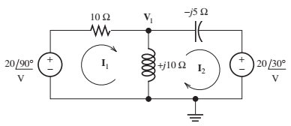
example 1
Find Mesh Currents I1 and I2

Slide 4
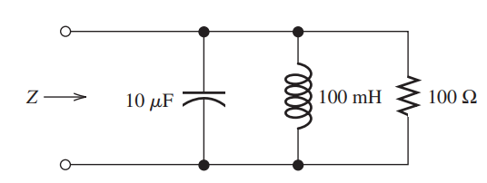
example 2
Compute the complex impedance of the network shown in Figure for ω = 500. Repeat for ω = 1000 and ω = 2000. Give the answers in both polar and rectangular forms

Slide 5


Ac POWER calculations

Slide 6











Current, Voltage, and Power for a Resistive Load
$$v\left(t\right)=V_{m}\cos\left(ωt\right)$$
$$i\left(t\right)=I_{m}cos⁡(ωt)$$
$$p\left(t\right)=v\left(t\right)i\left(t\right)=V_{m}I_{m}\cos^{2}⁡(ωt)$$
Current, Voltage, and Power for a Inductive Load
$$v\left(t\right)=V_{m}\cos\left(ωt\right)$$
$$i\left(t\right)=I_{m}\cos\left(ωt−90\right)=I_{m}sin⁡(ωt)$$
$$p\left(t\right)=v\left(t\right)i\left(t\right)=V_{m}I_{m}cos(ωt)sin⁡(ωt)$$
Using trigonometric identity cos(x) sin(x) = (1/2) sin(2x)
$$p\left(t\right)=v\left(t\right)i\left(t\right)=\frac{V_{m}I_{m}}{2}sin⁡(2ωt)$$

Slide 7




Current, Voltage, and Power for a Capacitive Load
$$v\left(t\right)=V_{m}\cos\left(ωt\right)$$
$$i\left(t\right)=I_{m}\cos\left(ωt+90\right)=−I_{m}sin⁡(ωt)$$
$$p\left(t\right)=v\left(t\right)i\left(t\right)=−V_{m}I_{m}cos(ωt)sin⁡(ωt)$$
Using trigonometric identity cos(x) sin(x) = (1/2) sin(2x)
$$p\left(t\right)=v\left(t\right)i\left(t\right)=−\frac{V_{m}I_{m}}{2}sin⁡(2ωt)$$

Slide 8
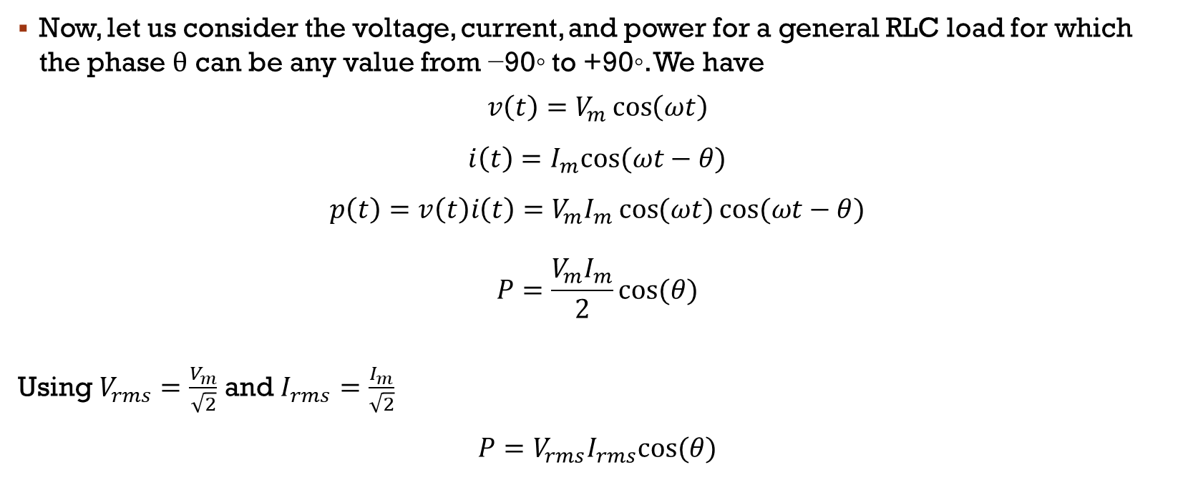





Power Calculations for a General Load
Now, let us consider the voltage, current, and power for a general RLC load for which the phase θ can be any value from −90◦ to +90◦. We have
$$v\left(t\right)=V_{m}\cos\left(ωt\right)$$
$$i\left(t\right)=I_{m}cos⁡(ωt−θ)$$
$$p\left(t\right)=v\left(t\right)i\left(t\right)=V_{m}I_{m}⁡\cos{(ωt)}cos⁡(ωt−θ)$$
$$P=\frac{V_{m}I_{m}}{2}cos⁡(θ)$$
Using $V_{rms}=\frac{V_{m}}{\sqrt{2}}$ and $I_{rms}=\frac{I_{m}}{\sqrt{2}}$ $$P=V_{rms}I_{rms}cos⁡(θ)$$

Slide 9

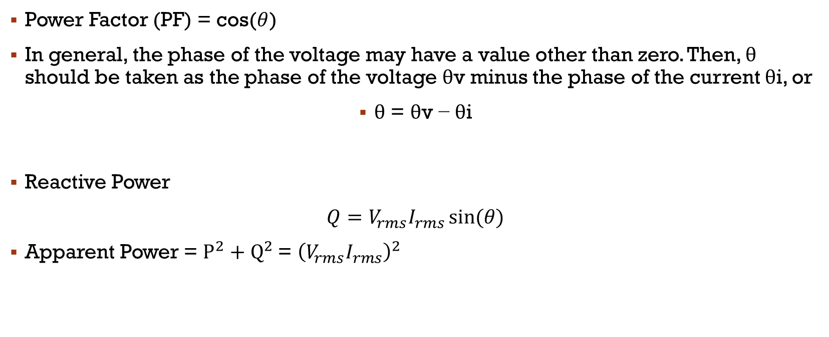


Power Factor & reactive power
Power Factor (PF) = cos($θ$)
In general, the phase of the voltage may have a value other than zero. Then, θ should be taken as the phase of the voltage θv minus the phase of the current θi, or
θ = θv − θi
Reactive Power
$Q=V_{rms}I_{rms}⁡sin(θ)$
Apparent Power = $P^{2}+Q^{2}$= ${\left(V_{rms}I_{rms}\right)}^{2}$

Slide 10
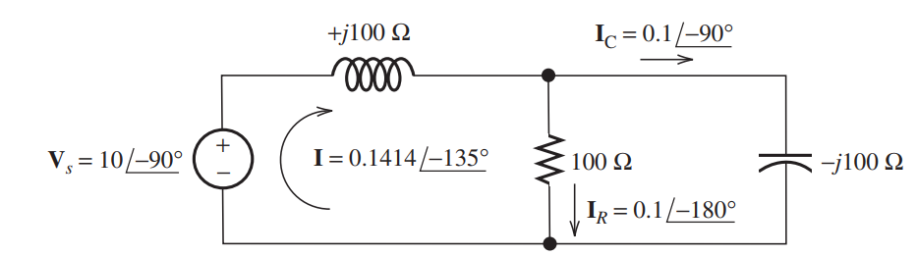
Ac power calculations
Compute the power, reactive power and apparent power taken from the source for the circuit

Slide 11
















Contents
Sinusoidal Voltage
Vm
w, f and T
RMS Values
Vrms, Irms
Pavg
Phasor Definition
Complex Impedances
Steady-state Analysis
Kirchhoff's Laws
Node Voltage Analysis
Mesh Current Analysis
AC Power Calculations
Active Power
Reactive Power
Power Factor
Apparent Power

